Slide 1
A Gender of One’s Own: Examining Queer Theory in Virginia Woolf
Presenter: Cora Moss
Advisor: Elizabeth Young

Slide 2
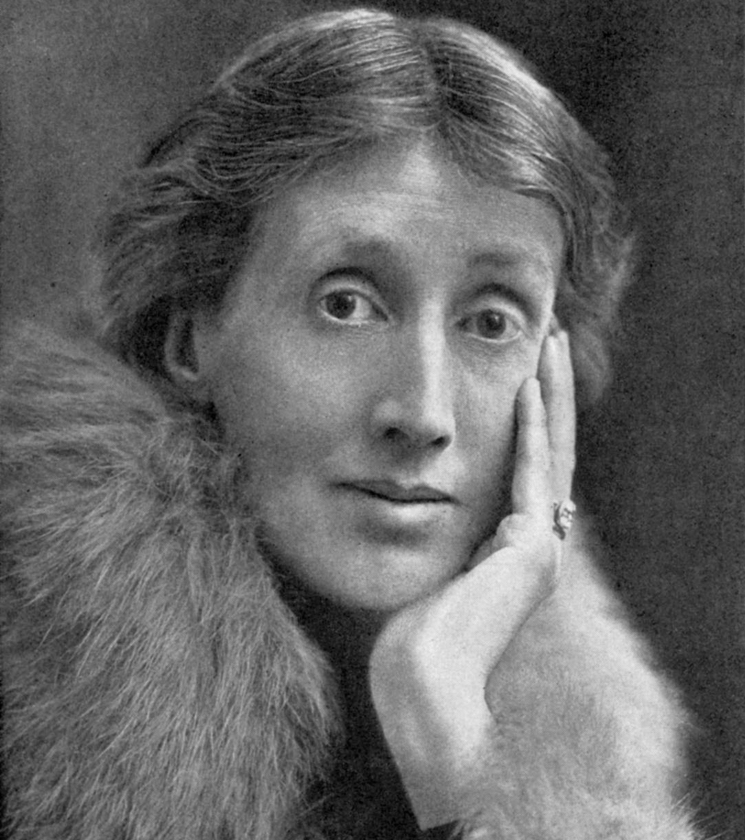
Photo of Virginia Woolf

Slide 3
Overview
Feminist theory is present in all of Virginia Woolf’s writing, from her fiction to nonfiction. Although the queer themes are subtler, a necessity of the time, they are still prevalent and this study seeks to examine them more closely.
This study is part of an ongoing semester of independent study on several of Woolf’s key works– Mrs. Dalloway, Orlando, A Room of One’s Own, Three Guineas and To The Lighthouse.
This presentation will be focusing primarily on Orlando and A Room of One’s Own, to show the depth of Woolf’s talent and highlight the key themes, with supplemental readings from the other texts and a variety of secondary research.

Slide 4
Timeline of Woolf’s works
Mrs. Dalloway (1925)
To The Lighthouse (1927)
Orlando: A Biography (1928)
A Room of One’s Own (1929)
Three Guineas (1938)

Slide 5
Research Questions
The following research questions formed the basis of this study, as I sought to analyze how they apply to Woolf’s writing:
How do women navigate social spheres traditionally dominated by men?
What impact does it have on mental health to live in a society which treats queerness as an abomination and women as second-class citizens?
How do queerness and feminism intertwine?
What is the interplay between gender identity and sexual orientation?

Slide 6
A Room of One’s Own (nonfiction) and Educational Inequality
Woolf highlights the inequality between educational standards for men and women– women are restricted from accessing the same quality of education and the same resources that men can.
With educational inequality comes financial inequality, which leads to further inequality for future generations.
Without a change to society, women can’t navigate social spheres traditionally dominated by men.
Women writers also struggle to navigate the same social spheres that men do. Everything is harder for them, and in the case of someone like Judith Shakespeare, being a talented writer would destroy their lives.

Slide 7
A Room of One’s Own quotes
“A woman must have money and a room of her own if she is to write fiction” (p. 4).
“A man’s figure rose to intercept me… his face expressed horror and indignation”(p. 6).
“He was a Beadle*; I was a woman” (p.6).
“Let me imagine… what would have happened had Shakespeare had a wonderfully gifted sister, called Judith… she was as adventurous, as agog to see the world as he was. But she was not sent to school. She had no chance of learning grammar and logic, let alone of reading Horace and Virgil” (p.46-47).
* A Beadle is an official of a church or university.

Slide 8
Orlando (fiction) and Queer Theory
Orlando, a novel, features a gender-bending hero/heroine who effortlessly goes from male to female and romances both men and women.
Orlando is also a clear love letter to Vita Sackville-West, with the dedication “To V. Sackville-West” and the many photos of Vita dressed up as the titular heroine.
Due to the fact that it reads as a fantasy, with the character of Orlando living for approximately 400 years, Woolf was able to touch on more overt queer themes than she would have been able to, had the book been grounded in reality.
By having the hero/heroine change gender halfway through, Woolf highlights the differences in society for men and women.

Slide 9
Orlando quotes
“In normal circumstances, a lovely young woman alone would have thought of nothing else; the whole edifice of female government is based on that foundation stone; chastity is their jewel, their centre piece… But if one has been a man for thirty years or so… one does not perhaps give such a very great start about that” (p. 153-4).
“Could I, however, leap overboard and swim in clothes like these? No! Therefore, I should have to trust the protection of a blue-jacket” (p. 154).
“Though she herself was a woman, it was still a woman she loved; and if the consciousness of being of the same sex had any effect at all, it was to quicken and deepen those feelings which she had had as a man” (p. 161).
“If [returning to England] meant conventionality, meant slavery, meant deceit, meant denying her love, fettering her limbs, pursing her lips, and restraining her tongue, then she would turn about with the ship and set sail once more for the gipsies” (p. 163).

Slide 10
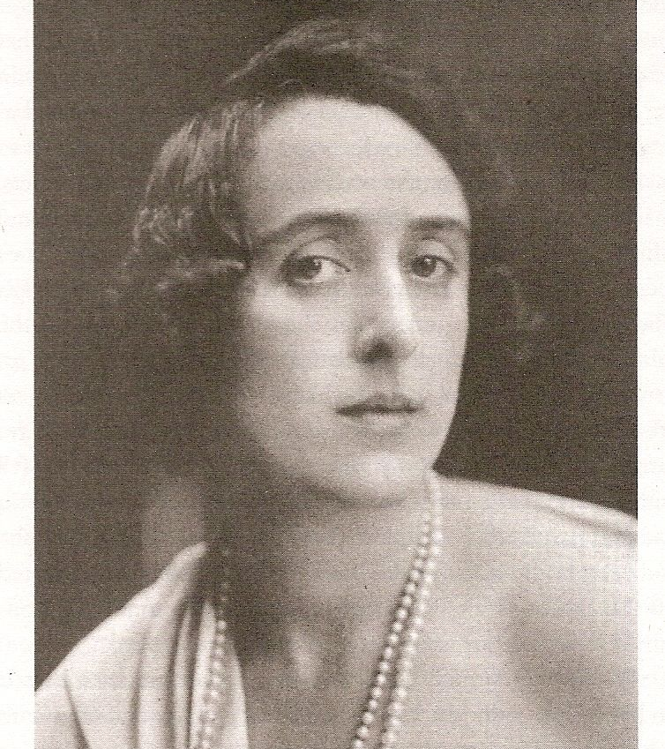
Vita as Orlando
Vita Sackville-West poses as the heroine Orlando for Woolf’s book of the same name. This photo, along with several others, are featured in the mock biography.

Slide 11
A Room of One’s Own and Lesbianism
Woolf explores themes of lesbianism in A Room of One’s Own with the famous line “Chloe liked Olivia.” Although it couldn’t afford to be explicit, it suggests a relationship between two women that does deeper than friendship.
Woolf highlights the need for a dedicated space for women, free from men who would judge them for having these taboo feelings.

Slide 12
A Room of One’s Own quotes
“Are there no men present? Do you promise me that behind that red curtain over there the figure of Sir Chartres Biron is not concealed? We are all women, you assure me? Then I may tell you that the very next words I read were these– “Chloe liked Olivia…” Do not start. Do not blush. Let us admit in the privacy of our society that these things happen. Sometimes women do like women” (p. 82).
“Chloe liked Olivia for perhaps the first time in literature” (p. 82).

Slide 13
Analyses of Research Questions
Women struggle to navigate social spheres dominated by men, because they are not given equal opportunities. They are forced to comply by the rules set by men, lest they face backlash.
This fear of backlash, combined with a lack of opportunities, creates a negative impact on women’s mental health, particularly queer women. Woolf must dance around the topic of sapphism– Orlando cannot openly love Sasha, Clarissa cannot openly love Sally, Chloe can only “like” Olivia.
Feminism and queerness intertwine naturally– “sapphist” and lesbian identities are inherently feminist. Both queer identity and feminist frameworks threaten the patriarchy.

Slide 14
Subversion of Gender Roles
Orlando explores and subverts gender in a variety of ways– there is the titular hero/heroine who changes from man to woman, but there are other ways in which gender is analyzed and challenged.
This is seen first in Sasha, the Russian Princess– when Orlando first meets her, he catalogues various parts of her body, trying to determine if she is male or female.
Woolf also presents the Archduke/Archduchess Harry/Harriet, who is a man, but initially pretends to be a woman, to woo Orlando the man, before revealing his true identity as a man, to woo Orlando the woman.
Orlando dresses as a man occasionally, after becoming a woman, and at times pretends to be a man.
This all ties into themes brought up by Judith Butler in Gender Trouble– gender is a performance, and our ideas of gender and biological sex are artificially constructed.

Slide 15
Orlando and Gender Trouble quotes
Orlando:
“She was censuring both sexes equally, as if she belonged to neither; and indeed, for the time being, she seemed to vacillate; she was man; she was woman; she knew the secrets, shared the weaknesses of each” (p. 158).
“Her sex changed far more frequently than those who have worn only one set of clothing can conceive… from the probity of breeches she turned to the seductiveness of petticoats and enjoyed the love of both sexes equally” (p. 221).
Gender Trouble:
“When the constructed status of gender is theorized as radically independent of sex, gender itself become a free-floating artifice, with the consequence that man and masculine might just as easily signify a female body as a male one, and woman and feminine a male body as easily as a female one” (p. 6).

Slide 16
Conclusion
Despite Woolf’s works being written nearly 100 years ago, many of her arguments still ring true for today– society has made leaps and bounds in terms of equality for women and acceptance of queer identities, but there is still a long ways to go.
Woolf’s works are rich in feminist and queer theories, and reading her works easily proves why she is still such an important author today.

Slide 17
Bibliography of Secondary Criticism
Butler, Judith. Gender Trouble: Feminism and the Subversion of Identity. Routledge, 1990.
González, Esther Sánchez-Pardo. “What Phantasmagoria the Mind Is: Reading Virginia Woolf’s Parody of Gender.” Atlantis, vol. 26, no. 2, 2004, 75-86.
Knopp, Sherron E. ‘“If I saw You would You Kiss Me?”: Sapphism and the Subversiveness of Virginia Woolf’s Orlando.” PMLA, vol. 103, no. 1 (1988), pp. 24-34
Lee, Hermione. Virginia Woolf. Random House, 1996.
Sackville-West, Vita. The Letters of Vita Sackville-West to Virginia Woolf. Edited by Mitchell A. Leaska and Louise DeSalvo, William Morrow and Company, Inc, 1985.

Slide 18
Bibliography (continued)
Stevenson, Christina. “Here Was One Room, There Another”: The Room, Authorship and Feminine Desire in A Room of One’s Own and Mrs. Dalloway.” Pacific Coast Philology, Vol. 49, No. 1, 2014, pp. 112-132
Stokoe, Kayte. “Fucking the Body, Rewriting the Text: Proto-Queer Embodiment through Textual Drag in Virginia Woolf’s Orlando (1928) and Monique Wittig’s Le Corps lesbien (1973).” Paragraph, Vol. 41, No. 3, 2018, pp. 301-316.
Zimmerman, Bonnie. “Is ‘Chloe Like Olivia’ A Lesbian Plot?” Women’s Studies Int. Forum, Vol. 6, No. 2, 1983, pp. 169-175

Slide 19
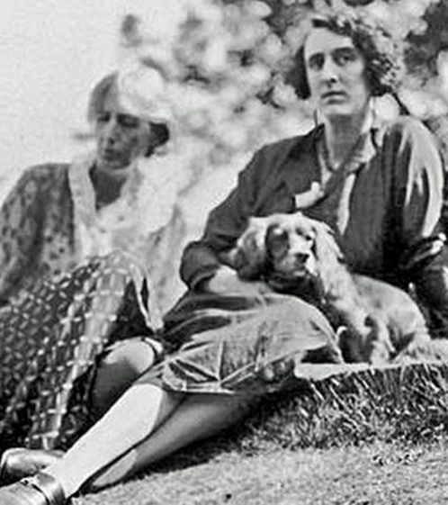
Virginia & Vita
Photographed by Leonard Woolf
Virginia, Vita and a dog lounge outside at Monk’s House, a cottage owned by Woolf and her husband, Leonard.

